Slide 1
German Fairy Tales

Slide 2
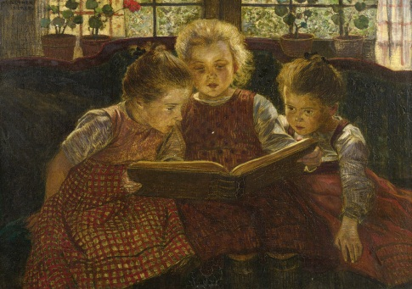
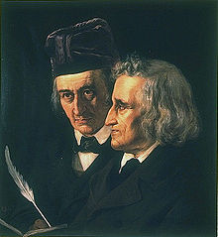
Brothers Grimm
Famous German linguists, cultural researchers and folklore collectors
Collected fairy tales in the late 18th century and early 19th century
Children's and Household Tales was first published in 1812
Many of these fairy tales turned into films

Slide 3
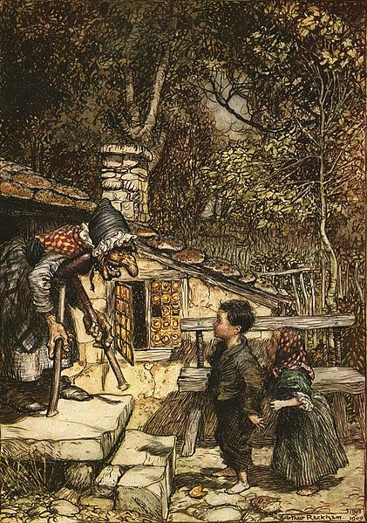
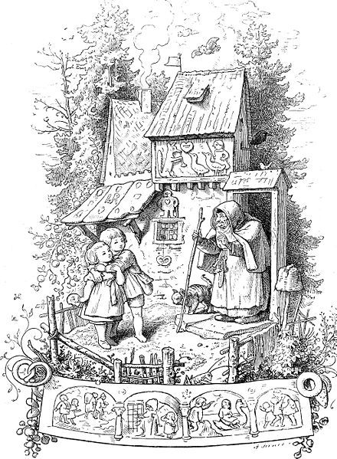
Hänsel und Gretel
Many different adaptations, even an opera
http://www.youtube.com/watch?v=QQilfo90Sus

Slide 4
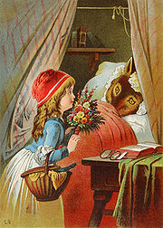
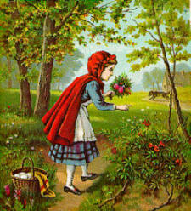
Rotkäppchen
Brothers Grimm give the fairy tale a happy ending
Was first mentioned in Histoires ou contes du temps passé, avec des moralités by Charles Perrault

Slide 5
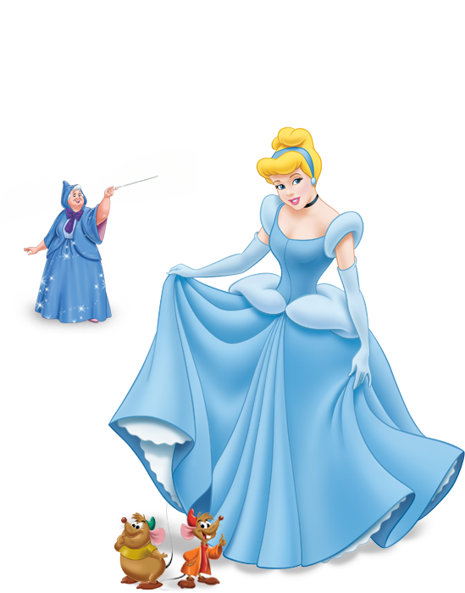
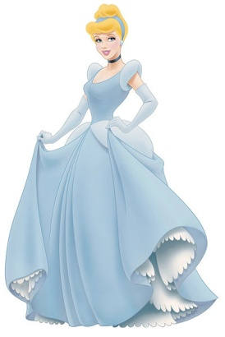
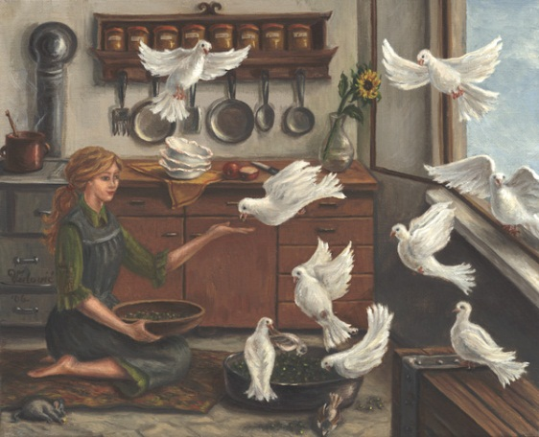
Aschenputtel
Original version a bit different than Disney film
Cinderella has a tree which is granting her wishes → Is giving her the dress and shoes to go to the dance

Slide 6
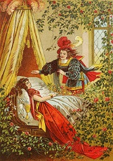
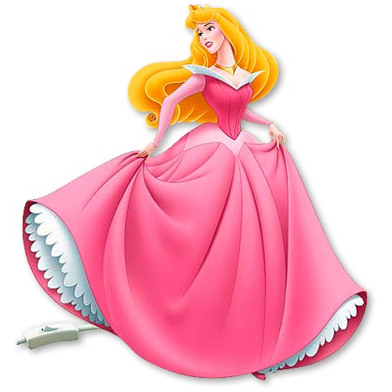
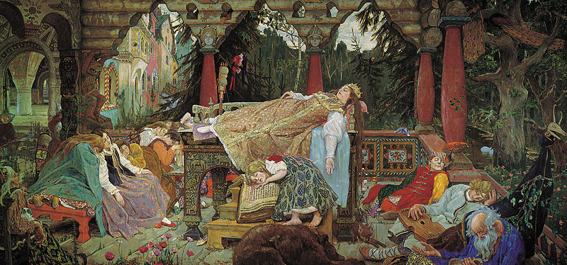
Dornröschen
It was first published by Charles Perrault in Histoires ou contes du temps passé in 1697

Slide 7
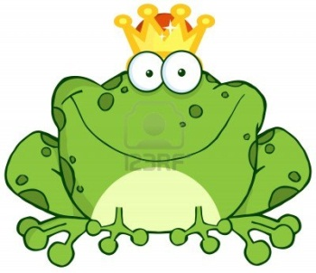
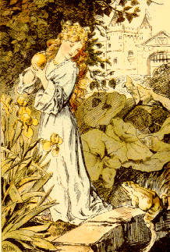
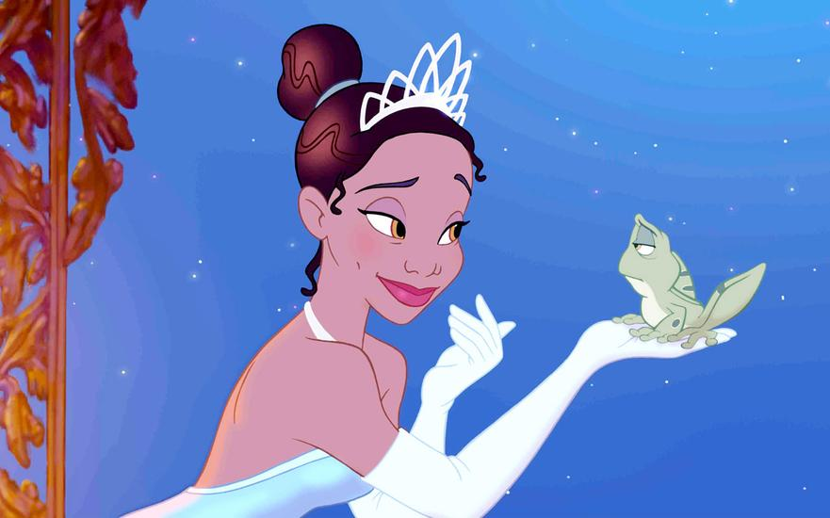
Der Froschkönig
A spoiled princess reluctantly befriends a frog , who magically transforms into a handsome prince
In the original Grimm version of the story the frog's spell was broken when the princess threw it against a wall in disgust

Slide 8
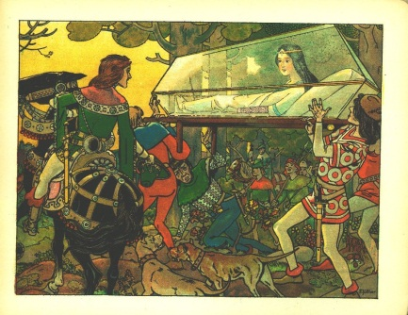
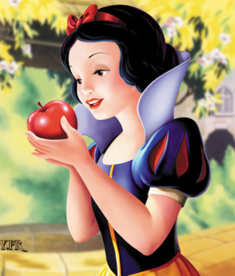
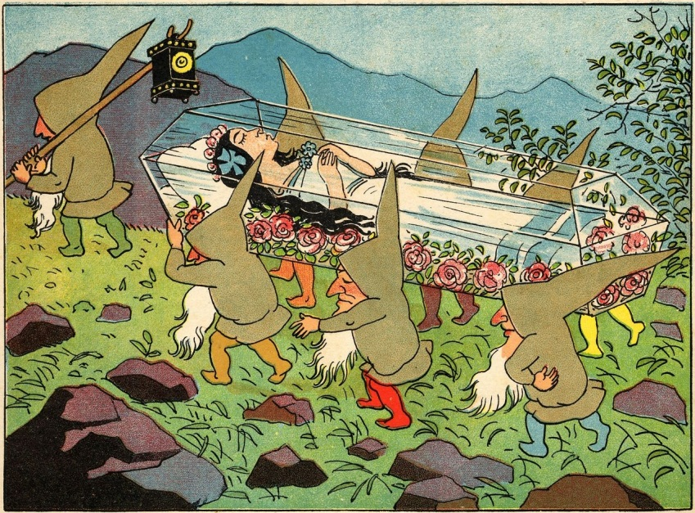
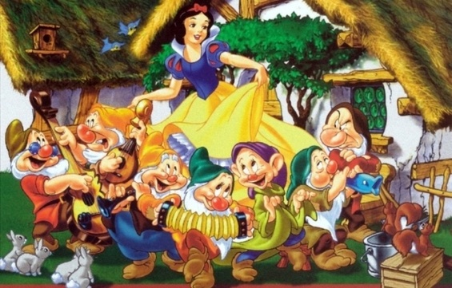
Schneewittchen
Many adaptations and variations
In the first version the villain was Snow White´s jealous mother
Dwarfs became names in Disney´s variation

Slide 9
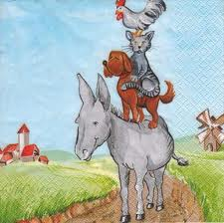
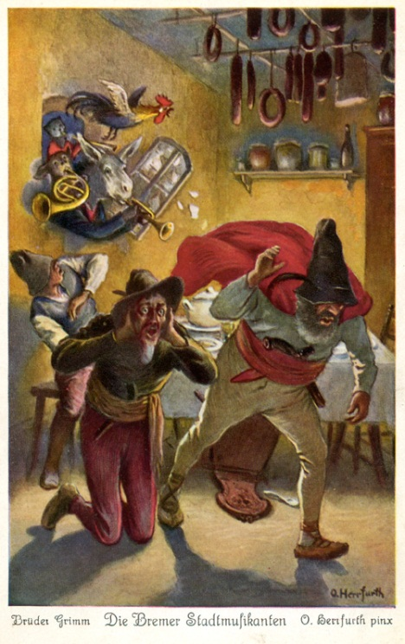
Die Bremer Stadtmusikanten

Slide 10
Next Week:
30th of January:
FRENCH SPORTS

