Slide 1
L’école en France

Slide 2
Sample timetable for secondary school pupils
 | lundi | mardi |  | mercredi | jeudi | vendredi
8h30-9h20 | français | LV1 |  | français | LV2 | maths
9h20-10h10 | maths | maths |  | Histoire-géo | musique | français
10h10-10h30 | récréation
10h50-11h40 | histoire-géo | technologie |  | SVT | maths | LV1
11h40-13h00 | pause déjeuner
13h00-13h50 | LV2 | études |  |  | dessin | Histoire-géo
13h50-14h40 | SVT | Physique-chimie |  |  | français | études
14h40-15h00 | récréation
15h00-15h40 | études |  | EPS |  | technologie | études
15h40-16h30 | LV1 |  | EPS |  | études | EPS

Slide 3
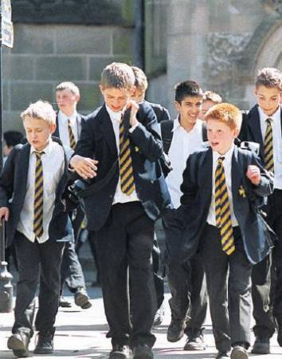
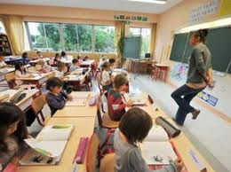
L’uniforme

Slide 4
A few facts
In France , school is mandatory from 6 to 16 years old.
Marks: from 0/20 to 20/20 (0 being the lowest)
« le redoublement »: if your marks are to low, you have to repeat a year.

Slide 5
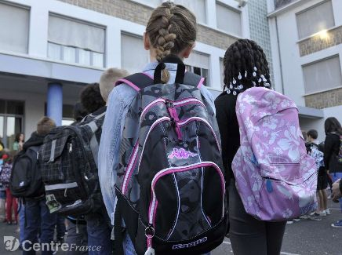
A few facts
Books: you have to buy them; same for all the stationary: the school does not provide anything.
Lots of children suffer form scoliosis or back pains because of the weight of the school bag

Slide 6
maternelle | 3 years | 1 year | Nursery school
primaire | CP | reception | Primary Scool
 |  | Year 1
 | CE1
 |  | Year 2
 | CE2
 |  | Year 3
 | CM1
 |  | Year 4
 | CM2
 |  | Year 5
 |  | Year 6
Collège | 6è | Year 7 | Secondary School
 |  | Year 8
 | 5è
 |  | Year 9
 | 4è
 |  | Year 10
 | 3è (Brevet)
 |  | Year 11 (GCSE)
lycée | 2nd | Year 12 | Colege
 | 1ere
 |  | Year 13 (A Level)
 | Terminale (BAC)

Slide 7
LE BREVET DES CollÈges
3 exams:
-FRENCH
-MATHS
-HISTORY and GEOGRAPHY

Slide 8
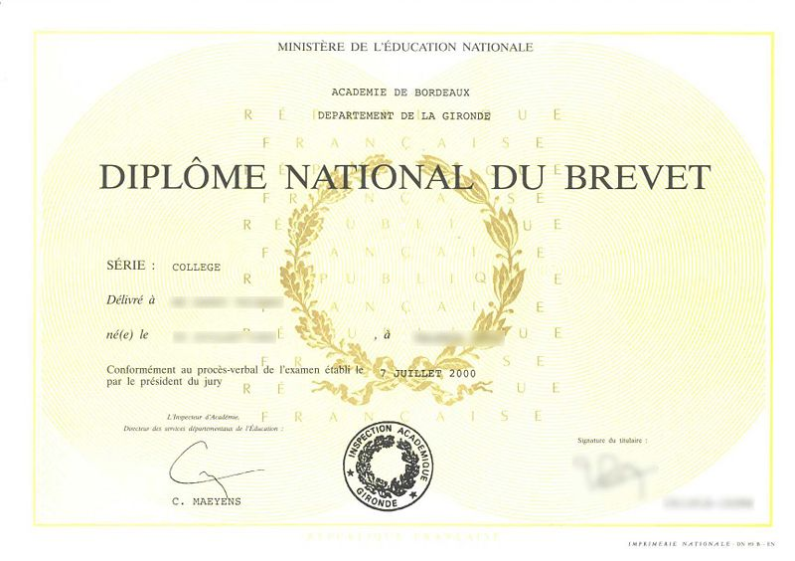
Le Brevet des collèges

Slide 9
LE BACCALAURéat
Differences with A Level
Subjets are mandatory:
You have to keep every subject util the end
Choose between 3 kinds of Baccalauréat:
-scientifique: 1ere: French written / oral
terminale: all the other subjects (8)
-économique et sociale: French written/oral + sciences
Terminale: all the other subjects (7)
-littéraire: French written/ oral + sciences+ maths
Terminale: all the other subjects (7)

Slide 10
